Slide 1
Steering angle and speed prediction
for self driving car.
Team members:
1- Ahmed Araby Kamel
Supervisors:
General Supervisor: DR/ Maryam Nabil Al-Bery.
Supervisor: TA/ Basel Safwat.
Notes:
NOTE:
To change the image on this slide, select the picture and delete it. Then click the Pictures icon in the placeholder to insert your own image.

Slide 2
Content
Introduction
Survey
System Architecture
System Implementation
Results
Conclusion
Feature Work
Demo
Tools

Slide 3
Introduction

Slide 4
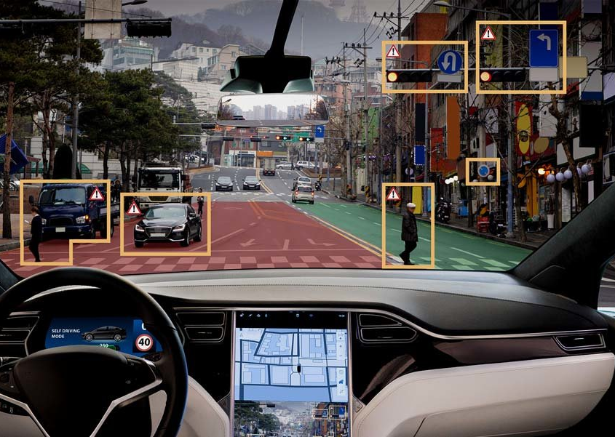
Problem Definition
Autonomous Driving is about giving the car the ability to drive itself as humans do, and this require the car to:
Predict the Steering angle
Predict Speed
build self-awareness of the surrounding environment (objects, cars, pedestrians, traffic lights, etc.).

Slide 5
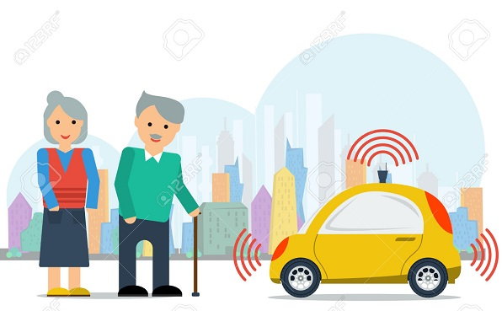
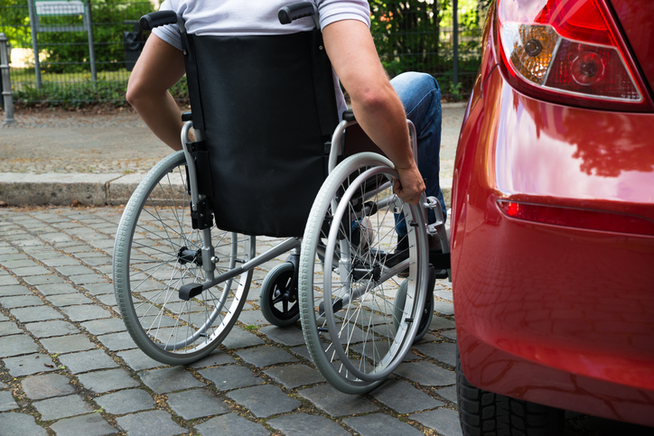
Motivation
Self Driving car technology have many benefits and applications that make it a very promising field.
Helping old people and people with disabilities .

Slide 6
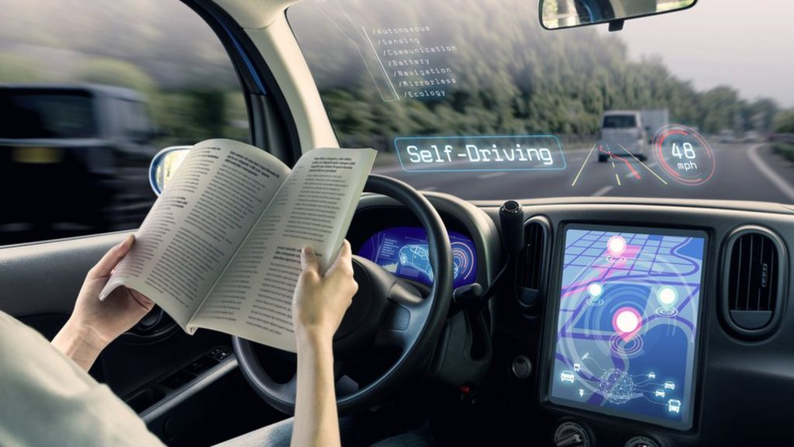
Motivation
Self Driving car technology have many benefits and applications that make it a very promising field.
More productivity as people don’t need to focus on the road for hours in their trip.

Slide 7
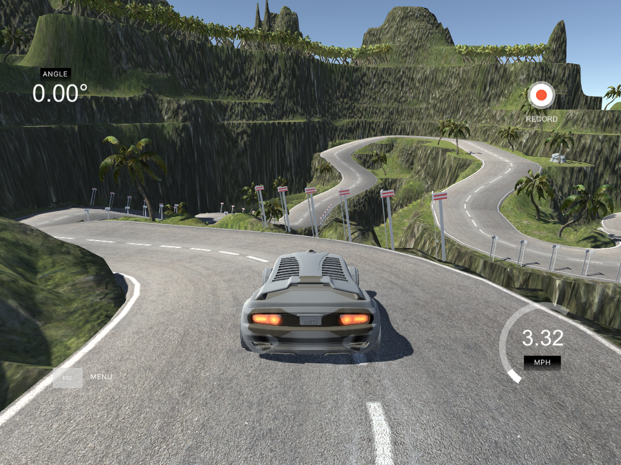
Objectives
This Work aims to build a deep learning model that will:
Predict Steering angle.
Predict Speed.
Test the model on Udacity self driving car simulator (Open Source).
Hence 2nd level of autonomy is achieved.

Slide 8
Survey

Slide 9
Name | Approach | Data-set | Accuracy | Advantage | Disadvantage
Lane Detection Algorithm for Intelligent Vehicles in Complex Road Conditions and Dynamic Environments | Classical approach using lane line detection | No-Data Set Rule Based | - |  | Not accurate Depends on the geometry which require the presence of lane line.
End to End Learning for Self-Driving Cars “NVIDIA” | Deep Learning, behavioral cloning using CNN | They collected their own data set (not public) | autonomous approximately 98% of the time | Direct prediction of the steering angle (end to end learning) | Don’t Consider temporal dependencies, of the camera stream. Can’t predict vehicle's speed.

Slide 10
Name | Approach | Data-set | Accuracy | Advantage | Disadvantage
End-to-End Deep Learning for Steering Autonomous Vehicles Considering Temporal Dependencies | Deep Learning, behavioral cloning using CNN - LSTM | Comma.ai (public data-set) | 17.77 MSE in degree for regression Using CNN 14.93 MSE in degree for classification using C-LSTM | Direct prediction of the steering angle (end to end learning) Consider temporal dependencies using LSTM. | Can’t predict vehicle's speed.
Self Driving RC Car using Behavioral Cloning | Deep Learning, behavioral cloning using CNN, they followed Nvidia paper | They collected their own data | - 84.5 % accuracy

Slide 11
Name | Approach | Data-set | Accuracy | Advantage | Disadvantage
End to end multi model multi task vehicle control for self Driving cars with visual perception | Deep Learning, behavioral cloning using CNN - LSTM | Udacity (Public Data Set) | Angle : 1.26 MAE in degrees. Speed : 0.19 MAE in m/s | They predict the speed using LSTM | Don’t take into account temporal dependencies of the camera stream.

Slide 12
System Architecture

Slide 13
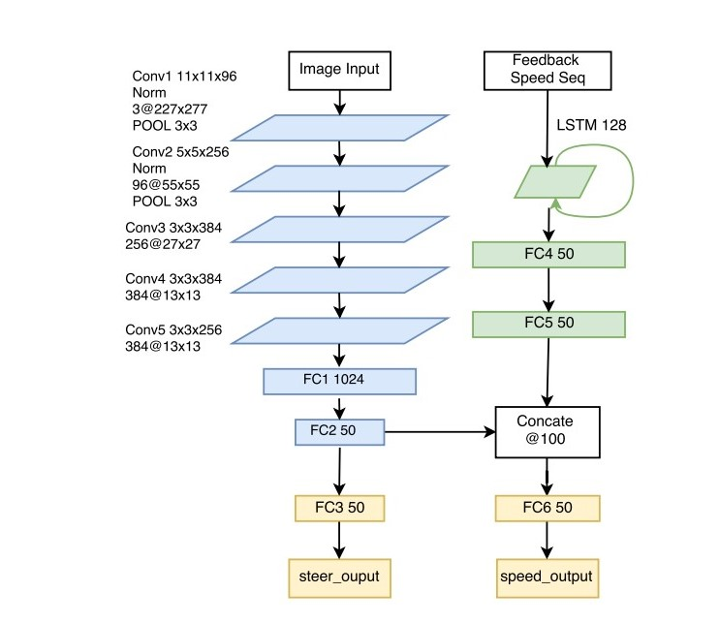
Multi modal Multitask Architecture
Predict the steering angle and the speed of the car
Applied Changes:
Input layer take RGB image with 70 pixel in height and 320 width.

Slide 14
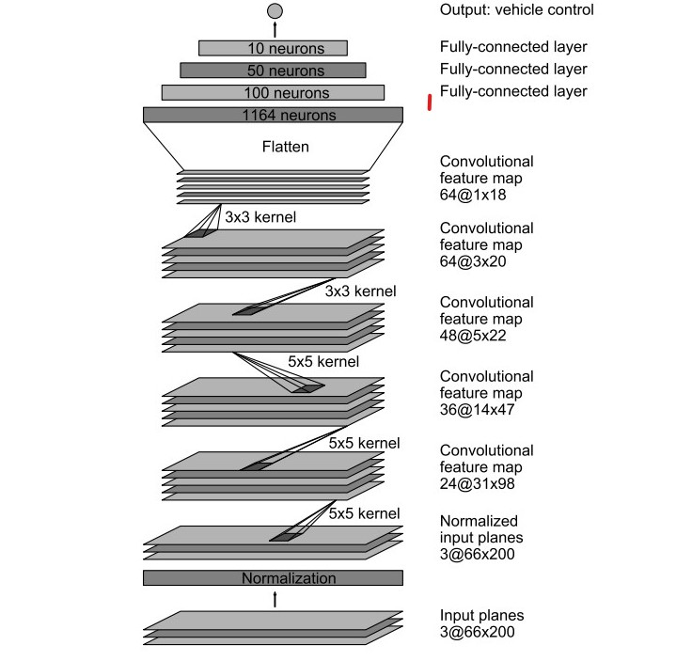
Nvidia Architecture
Predict only the steering angle of the car
Reason for using it is for testing the claim that multitask models is better than single task models, due to the regularization effect of the multitask loss function.
Applied Changes:
Input layer take RGB image with
70 pixel in height and 320 width.
Fully connected layers of the model have been edited from [100 , 50 , 10] to [200 , 100 , 50] neuron per layer.

Slide 15
System Overview

Slide 16
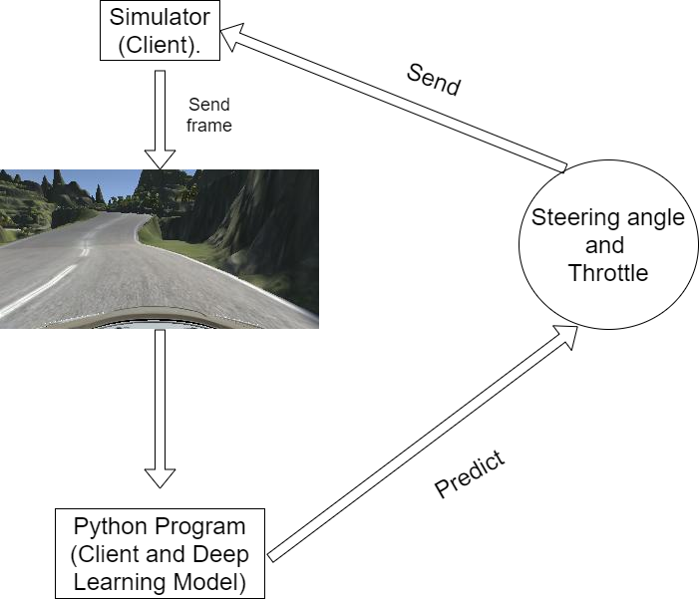
Udacity self Driving Car Simulator
Interaction between the Deep Learning model and the Simulator

Slide 17
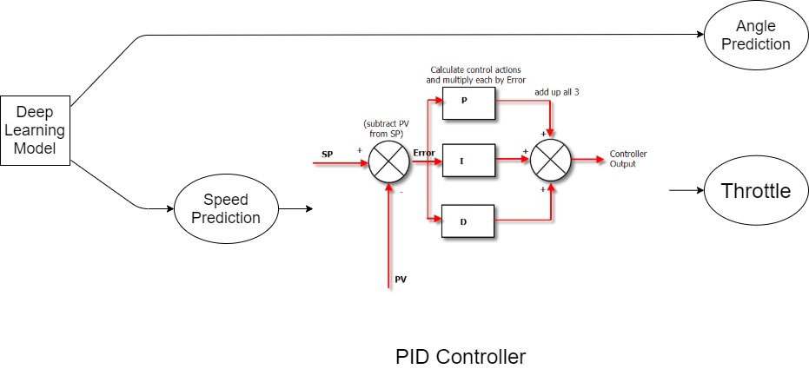
Model Predictions

Slide 18
System Implementation

Slide 19
Collecting Data
data set used to train the model is collected using Udacity self driving car Simulator.
Collected Data is :
images of the scene in front of the car from left, center and right cameras.
steering angle from the center camera perspective.

Slide 20
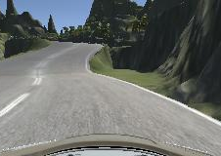
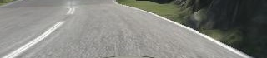
Preprocessing
image cropping to 320 X 70.
Normalizing Image pixel intensity into [0,1] range.
Normalizing speed values into [0, 1] range.
After Cropping
Before Cropping

Slide 21
Augmentation
To increase the variation in the data set in order to get more robust model that can handle challenging situations, Augmentation was required, Hence:
Left and right Camera Calibration
Horizontal Flipping
Adding shadows
Adding Noise
Blocking out random positions

Slide 22
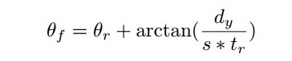
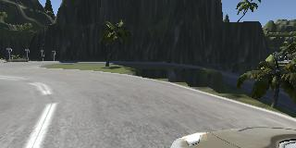
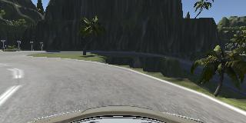
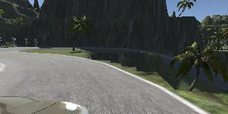
Left and right Camera Calibration
Data is collected using 3 different cameras on different positions
(left, center, right) of the driver view.
Only 1 angle is recorded for the center camera (Driver View).
Angle = 0.5728891 + 0.25
Angle = 0.5728891
Angle = 0.5728891 - 0.25

Slide 23
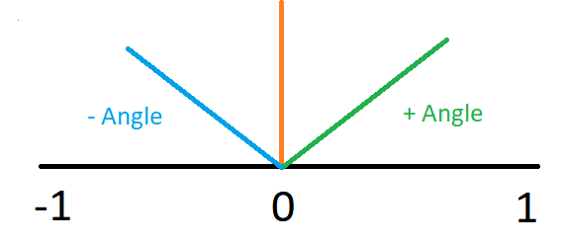
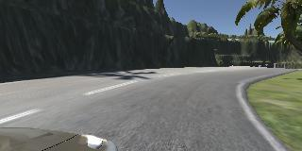
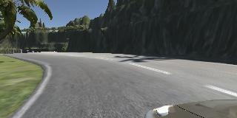
horizontal flipping
Angle = 0.3
Angle = - 0.3

Slide 24
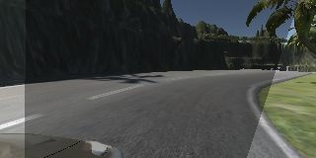
Adding shadows
Intensity of the shadows is randomly selected
Position of the shadows is randomly selected
Original
Adding Shadows

Slide 25
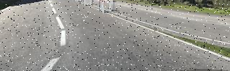
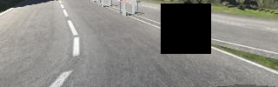
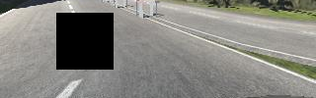
Adding Noise and Blocking Random Areas
Adding Noise:
Salt and pepper noise
Blocking Random Areas this would force the model to look at many important feature as random areas become black areas:
Random areas are selected every time.
Random size areas are selected every time.

Slide 26
Results

Slide 27
Results
Loss values for the main architecture "end to end multi model multitask Architecture"
Loss function for both tasks is Mean Squared Error
- | angle loss | speed loos
training | 0.0790 | 0.002
validation | 0.07612 | 0.002

Slide 28
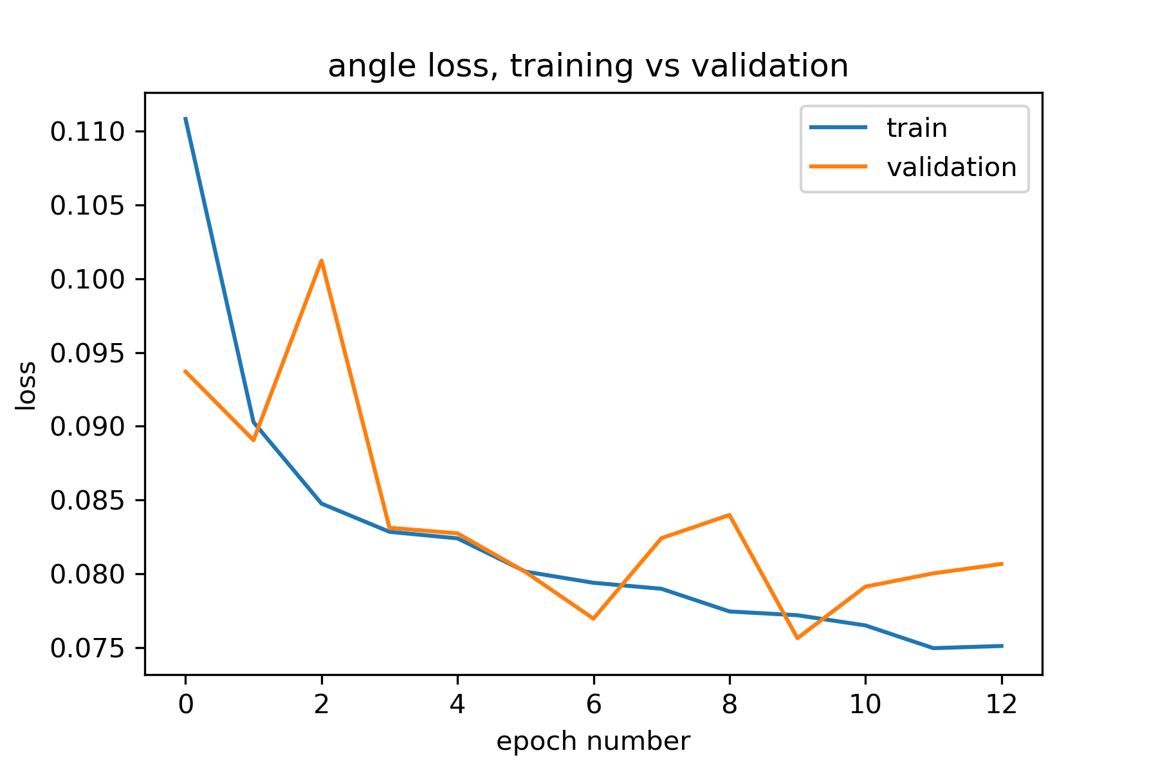
Results
Angle loss training Vs Validation.

Slide 29
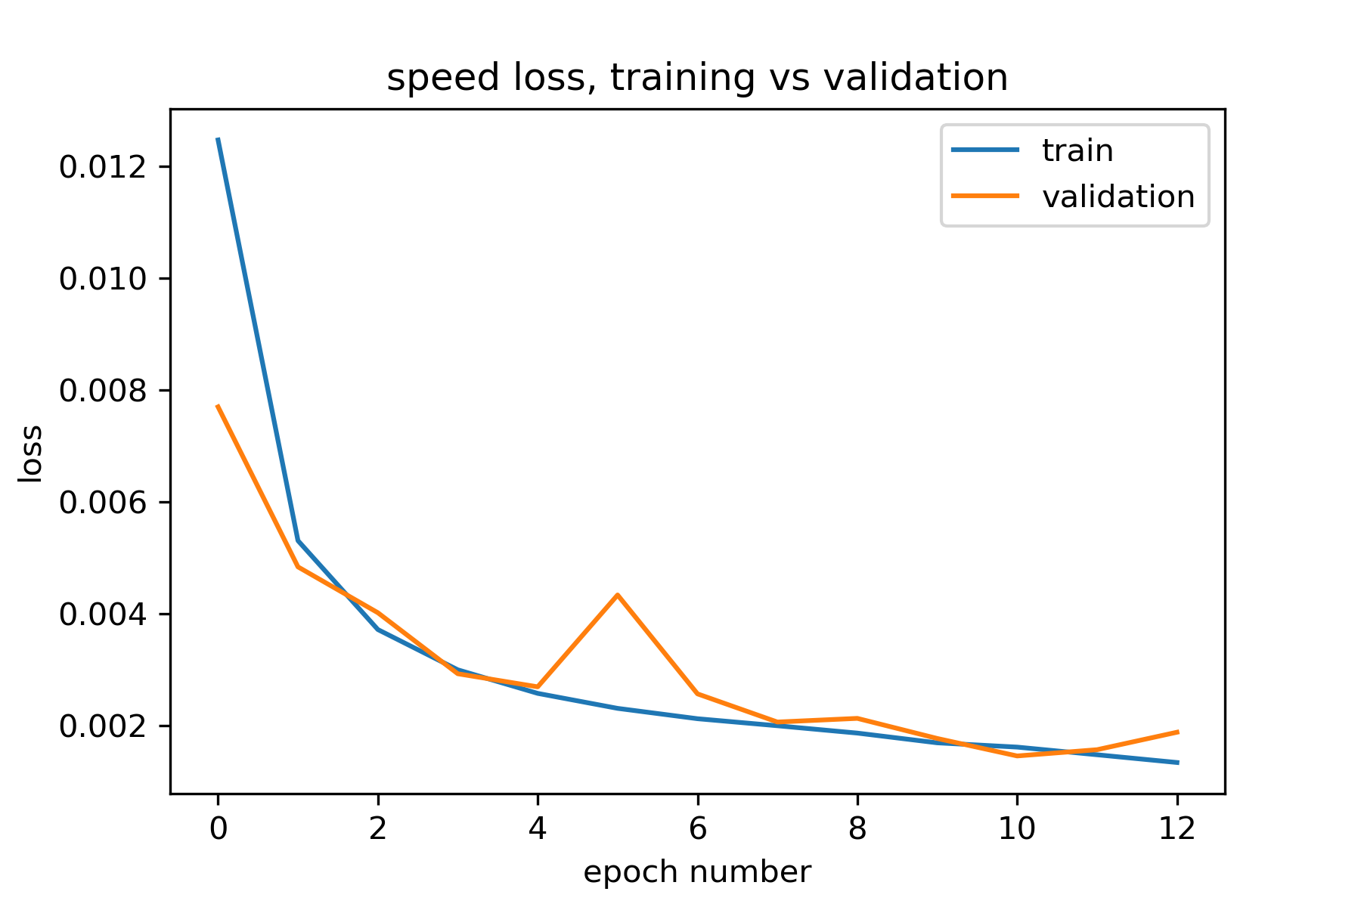
Results
Speed loss training Vs Validation.

Slide 30
Results
Comparing “Nvidia Architecture” with the “multi model Multitask Architecture” only using “angle loss” to verify the claim that “multitask Architectures” are better then “single task Architecture” because of the regularization effect of the multi loss function.
Architecture | training loss | validation loos
Multi model multi task Architecture | 0.0320 | 0.0685
Nvidia Architecture | 0.0790 | 0.7612

Slide 31
Conclusion
self driving car is a very promising technology with a complex stack of systems needed to work together to build a self driving car, in this work I showed one component of this stack which is steering angle and speed prediction.
Advantages:
solving the two problems in multi model multiTask architecture which helped the model to achieve generalization.
Disadvantages:
using a simple simulator for testing, because using another simulator with a complex environment would need additional systems to work with the speed and angle prediction model (object detection for collision detection)
speed prediction produce small values in straight roads it would be better if the model managed to go faster in empty straight road

Slide 32
Future Work
• use more complex simulator with complex environment like Carla with more systems deployed other
than the angle and speed prediction, i.e.(object detection, path planning etc.).
• continue my work on the real small toy car to deploy my work on it

Slide 33





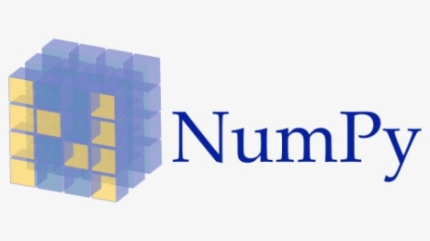
Software Tools
• python is the main programming language for this project
• keras is an open source deep learning library for building,
training and testing the model
• open cv for different preprocessing and augmentation techniques
• matplotlib for result visualization and data set analysis
• NumPy
• pandas for data set loading and manipulations
• flask it’s the server that receive the frames from the simulator and send
the commands for steering angle and speed back to the simulator.
• Sockets for communication.

Slide 34
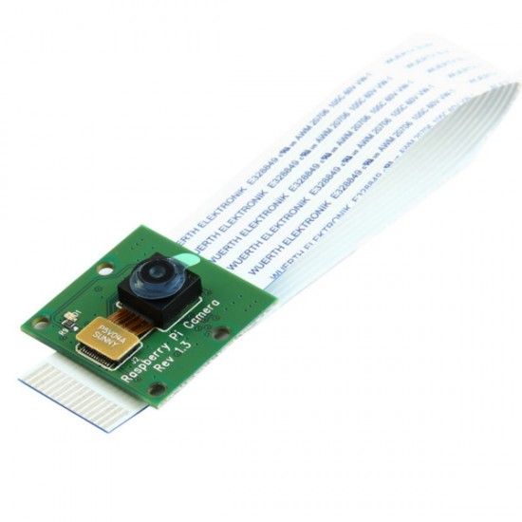
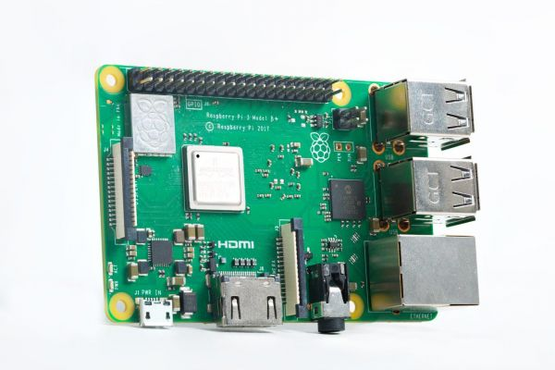
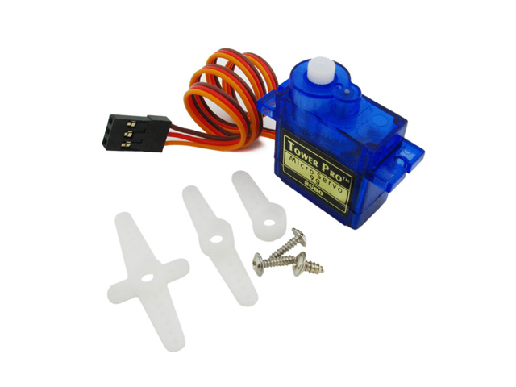
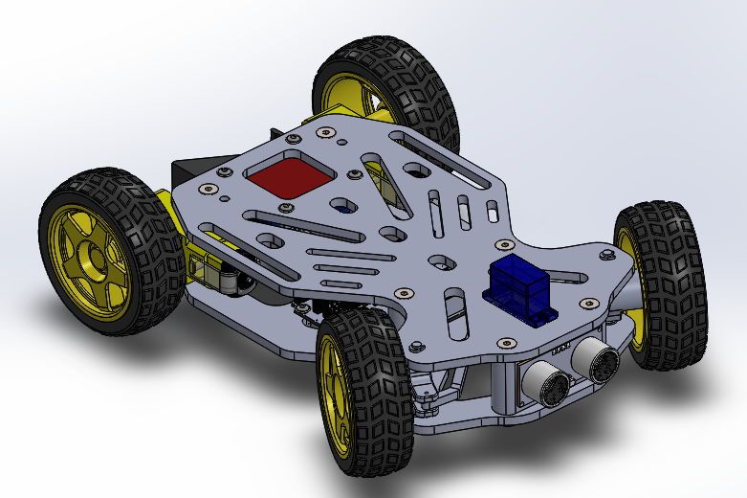
Hardware Tools
• raspberry pi
• raspberry pi camera
• DC motors
• servo motor
• 3D printed car chassis
• L298 motor driver

Slide 35
References
[1] Mariusz Bojarski, Davide Del Testa, et al. "End to End Learning for Self-Driving Cars". Nvidia, 25 Apr 2016
[2] Hesham M. Eraqi, Mohamed N. Moustafay, and Jens Honerz. "End-toEnd Deep Learning for Steering Autonomous Vehicles Considering Temporal Dependencies". 22 Nov 2017
[3] Zhengyuan Yang1, Yixuan Zhang1 , et al. "End-to-end Multi-Modal Multi-Task Vehicle Control for Self-Driving Cars with Visual Perceptions". Department of Computer Science, University of Rochester, Rochester NY 14627, USA. 2 Feb 2018.
[4] Rounak Hazra, Aman Kumar, B.Baranidharan. "Effect of Various Activation Function on Steering Angle Prediction in CNN based Autonomous Vehicle System". International Journal of Engineering and Advanced Technology (IJEAT). December, 2019.
[5] Shuyang Du, Haoli Guo, Andrew Simpson. "Self-Driving Car Steering Angle Prediction Based on Image Recognition". Stanford, 11 Dec 2019.
[6] Jingwei Cao, Chuanxue Song. "Lane Detection Algorithm for Intelligent Vehicles in Complex Road Conditions and Dynamic Environments". sensors, MDPI. 18 July 2019

Slide 36
References
[7] Michael Diodato, Yu Li, et al. "Winning the ICCV 2019 Learning to Drive Challenge" 23 Oct 2019.
[8] Aliasgar Haji, Priyam Shah, Srinivas Bijoor. "Self Driving RC Car using Behavioral Cloning". 10 Oct 2019.
[9] https://www.csimn.com/CSI_pages/PIDforDummies.html Last Retrieved on 12/8/2020
[10] https://github.com/udacity/self-driving-car-sim Last Retrieved on 12/8/2020
[11] https://rb.gy/mw6afd Last Retrieved on 12/8/2020
[12] https://github.com/Ahmed-Araby/Alien_Pilott Last Retrieved on 12/8/2020

Slide 37
[13] https://rb.gy/m1em0r Last Retrieved on 12/8/2020
[14] https://rb.gy/nkapvv Last Retrieved on 12/8/2020
[15] https://ruder.io/multi-task/ Last Retrieved on 12/8/2020

Slide 38
Thanks

